Slide 1

Northwind Traders Data Warehouse Project
Transforming specialty food import/export operations through comprehensive data warehouse implementation and business intelligence solutions.
This Project Made by :
Mostafa Ashraf
Abdelrahman Ramadan
Rana Shaaban
Mohamed Khaled

Slide 2

Business Context: Northwind Traders Overview
Company Profile
Core Operations
Northwind Traders operates as a fictitious specialty foods import/export company, serving as an ideal case study for data warehouse implementation in the food industry.
Three critical business areas drive success: Sales operations, Logistics management, and Supply Chain coordination across global markets.
Scale & Scope
Managing thousands of orders across diverse product lines, multiple geographic regions, and a worldwide customer base requiring sophisticated data analysis.

Slide 3
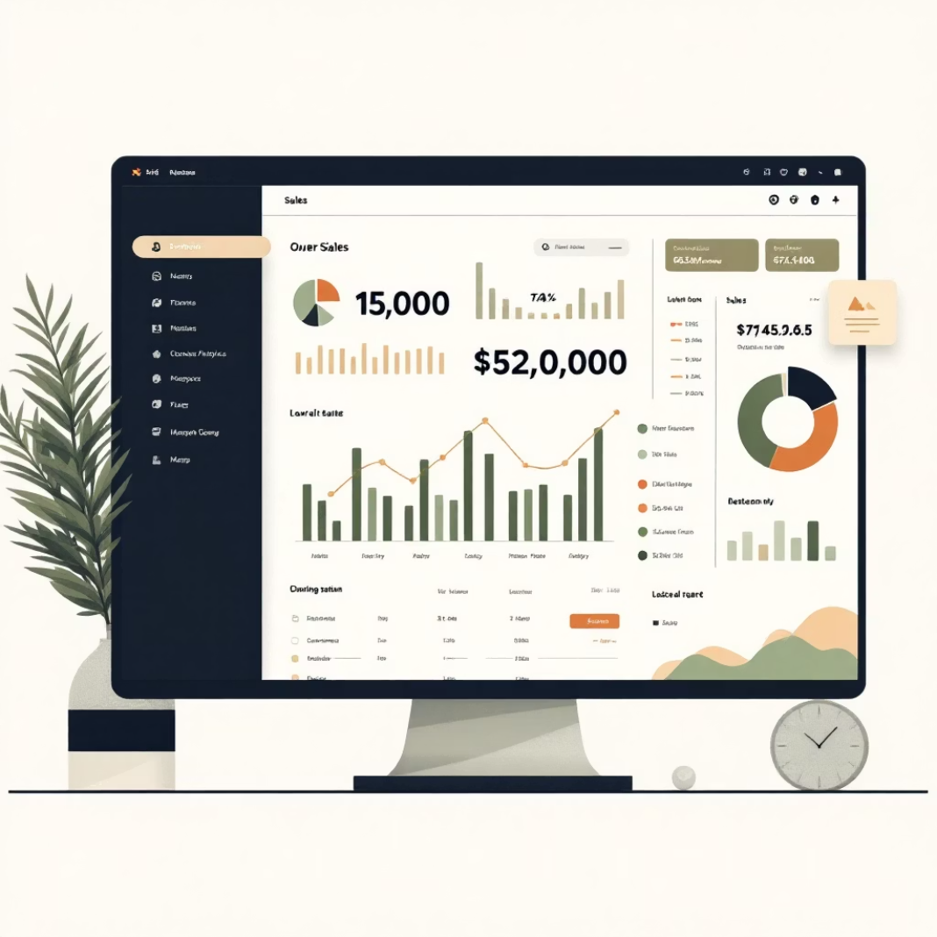

Business Facts
Sales Facts
Logistics Facts
Total sales revenue tracking
Average delivery time metrics
Sales trend analysis over time
Shipper performance evaluation
Profit margin calculations
Supply chain efficiency measures
Discount impact assessment
Customer satisfaction indicators

Slide 4







Business Dimensions
Products
Regions
Customers
Categories, suppliers, pricing
Geographic territories and markets
Demographics and purchasing behavior
Date & Time
Shippers
Suppliers
Temporal analysis dimensions
Delivery service providers
Product source management
Employees
Sales and operational staff

Slide 5

Modeling
Why Star Schema ?
Its simplified
Business-friendly design that offers faster query performance
Making it ideal for business intelligence (BI) tools and reporting systems
It supports multi-dimensional analysis → for example, analyzing sales by product, customer, or region.

Slide 6
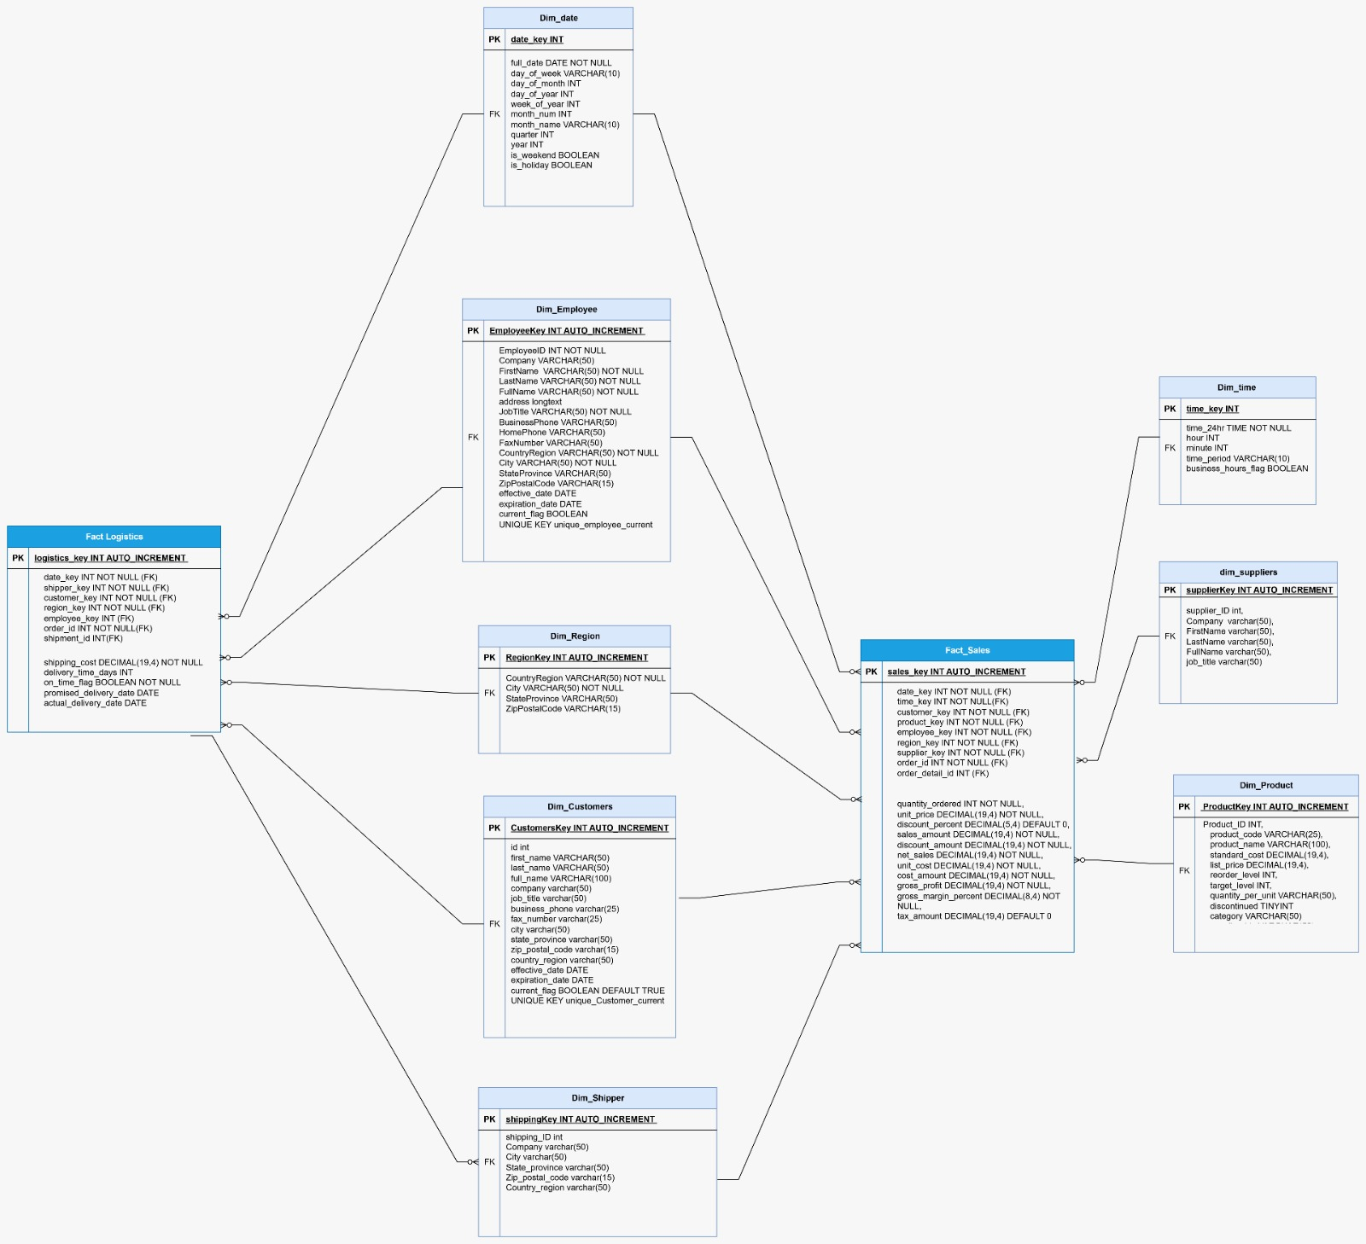
Star Schema Design for Northwind Traders

Slide 7
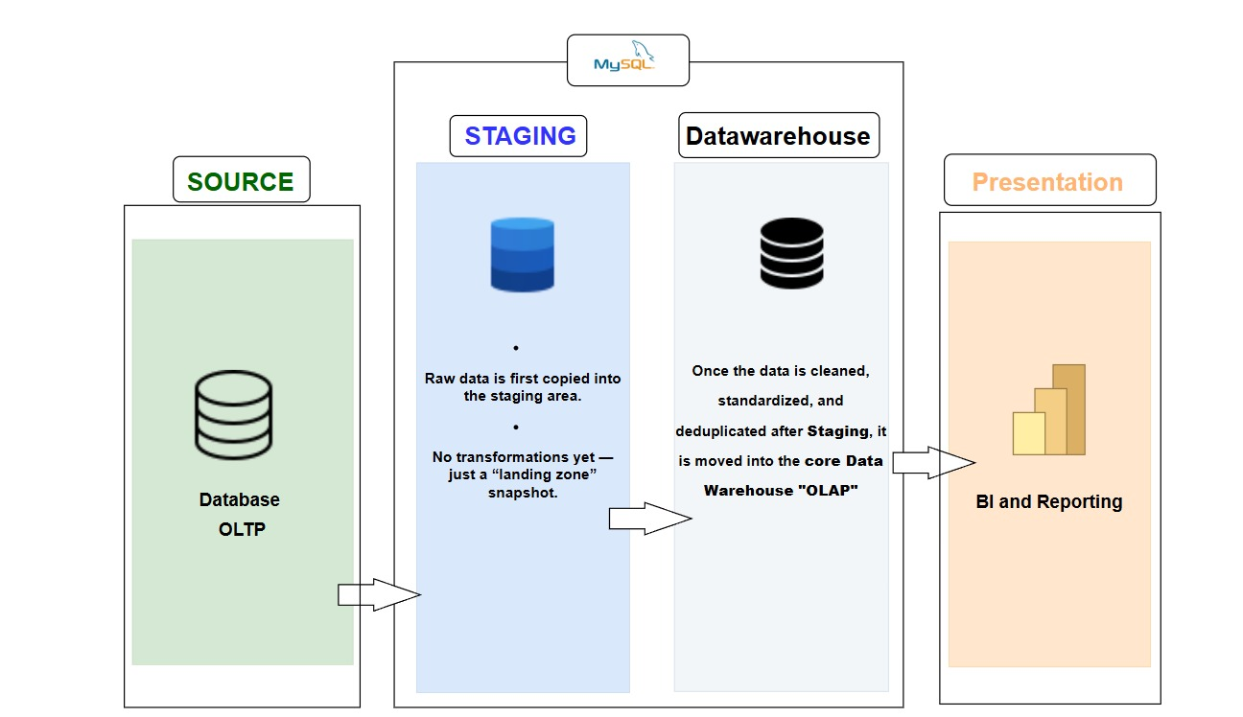
Data Warehouse Architecture: Kimball's Approach

Slide 8

Implementation Strategy
01
02
03
Staging Area
Data Profiling
Cleaning & Handling
Raw data ingestion and initial storage for processing
Quality assessment and pattern discovery across datasets
Standardization, deduplication, and error correction processes
04
05
DWH Facts & Dimensions
Business Questions
Structured modeling with fact tables and dimension hierarchies
Analytics-ready data supporting key business insights

Slide 9
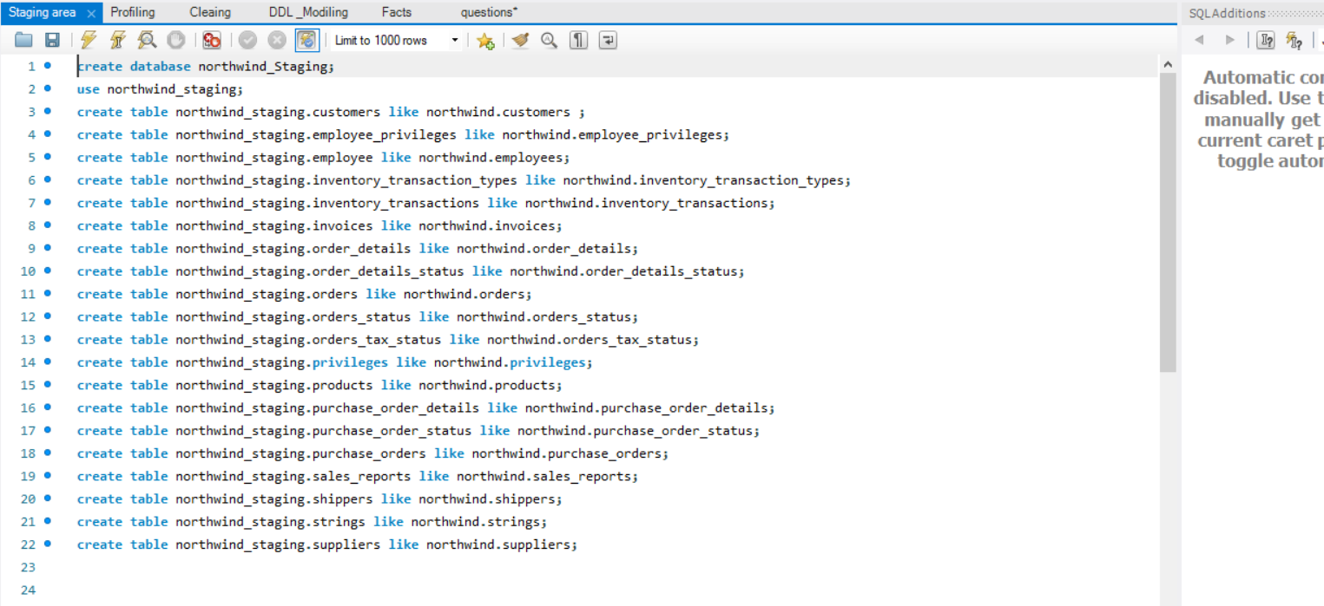
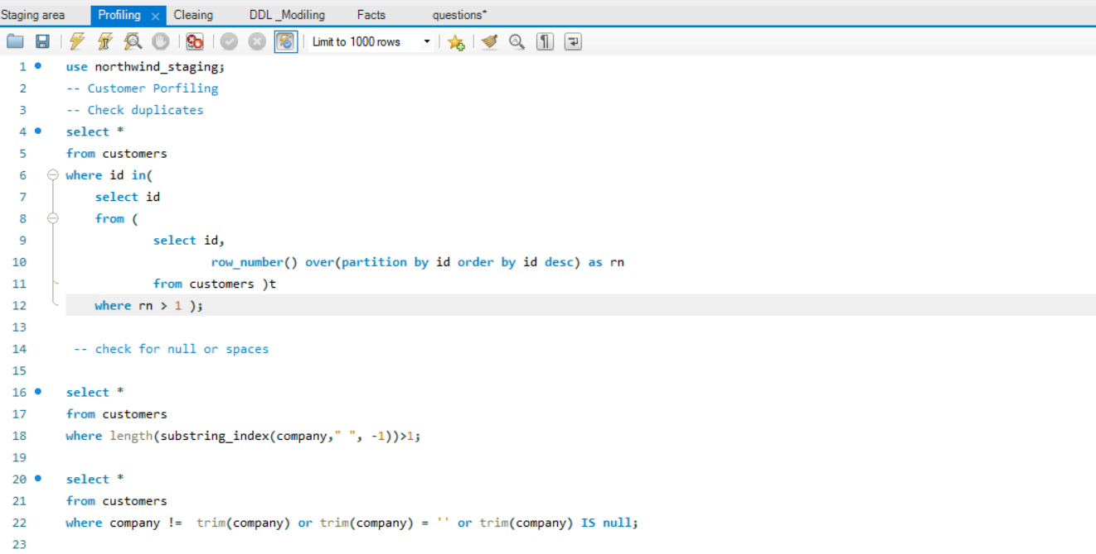
1- Staging
2- Profiling

Slide 10
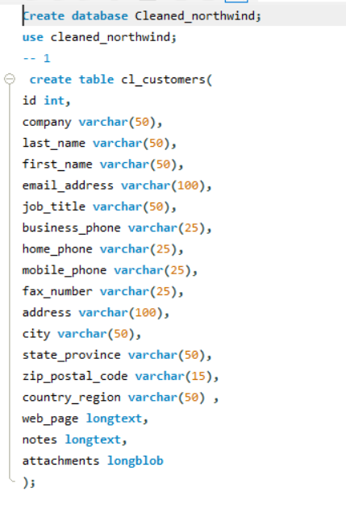
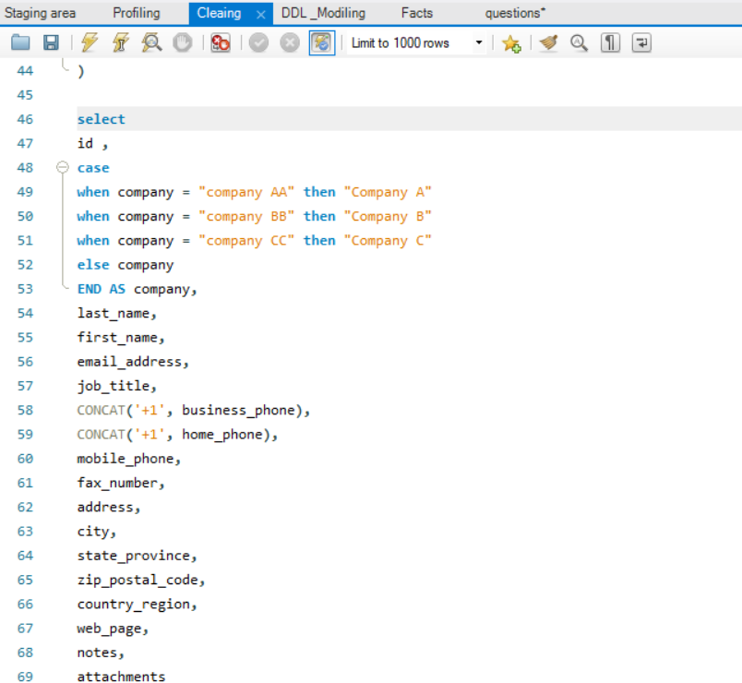
3- Cleaning

Slide 11
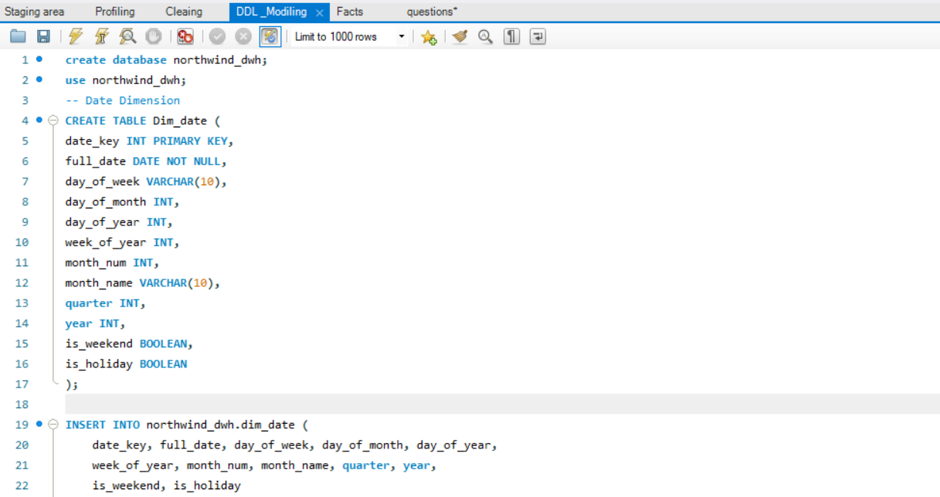
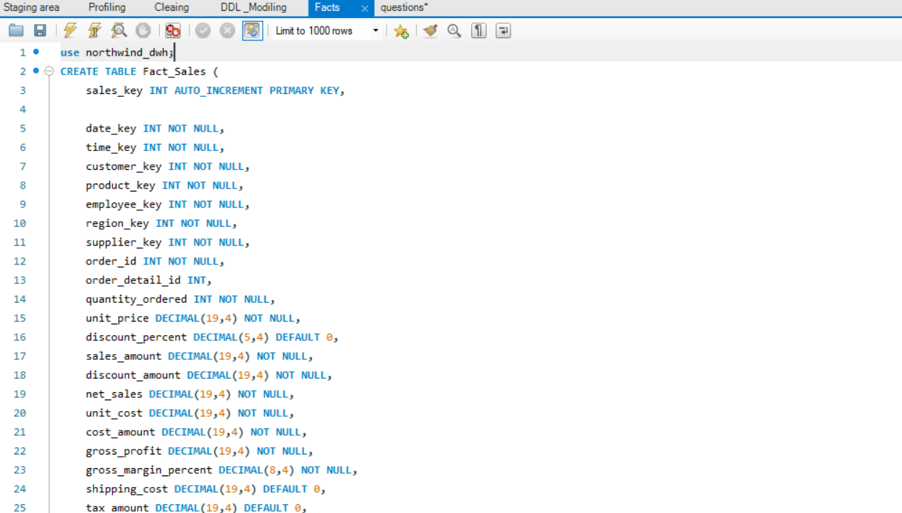
4- Dimensions & Facts

Slide 12
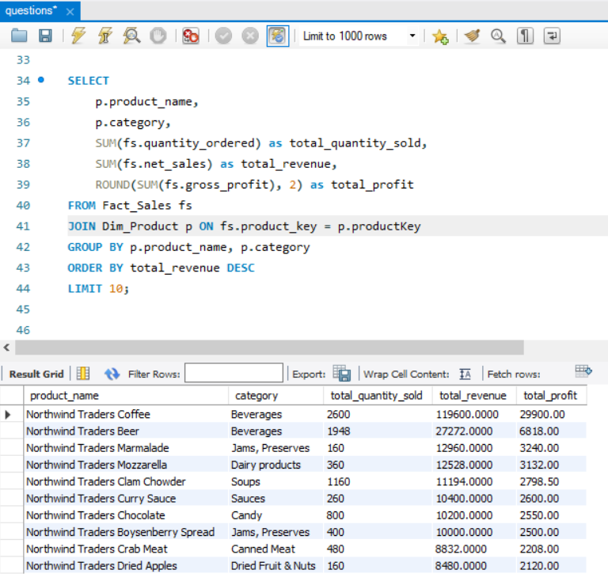
SQL Queries Answering Business Questions
Strategic business questions drive our data warehouse design,
enabling powerful analytical capabilities across all operational dimensions.
Sales Performance Analysis
"What are top 10 products ?"
Power BI transforms these SQL insights into interactive dashboards, business monitoring for stakeholders across the organization.

Slide 13
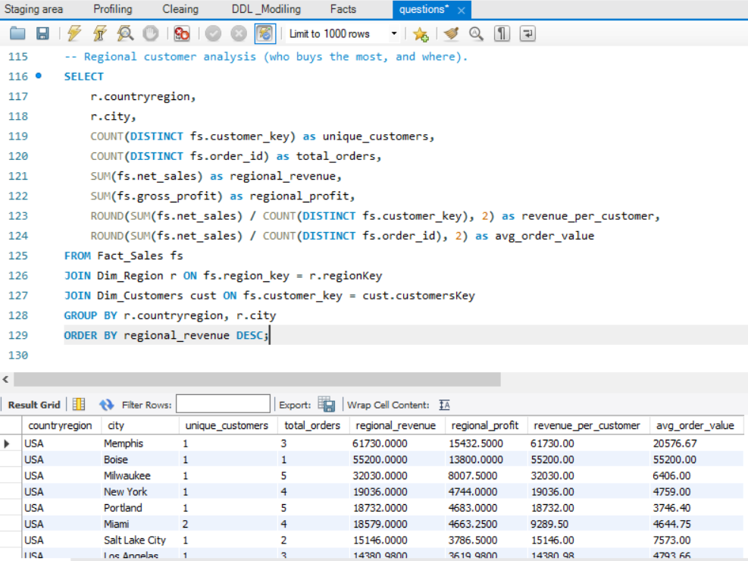
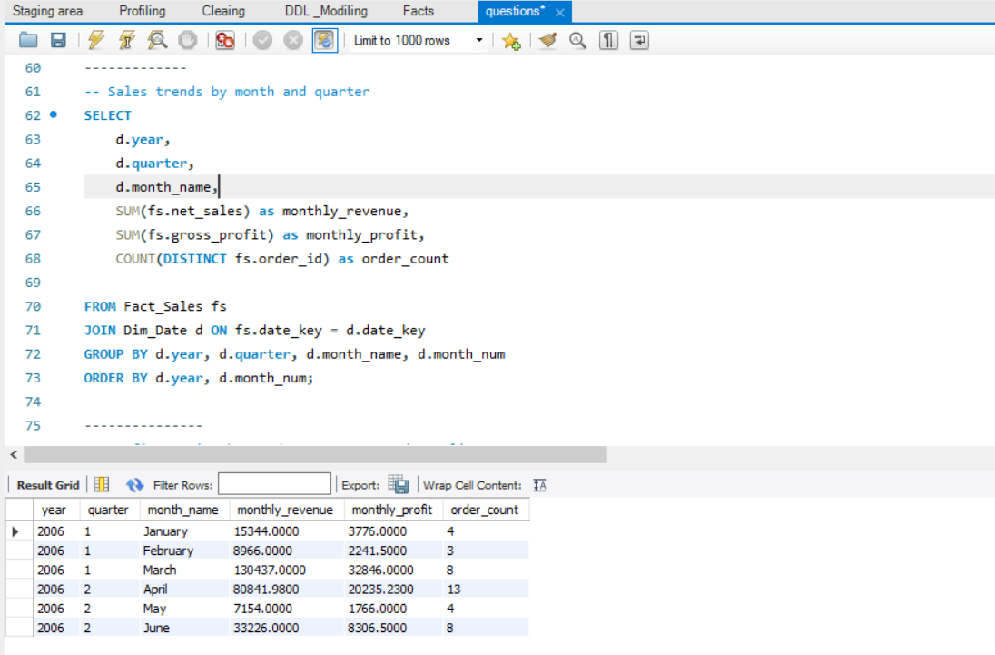
Sales Performance Analysis
Sales Performance Analysis
Regional customer analysis (who buys the most, and where)
Sales trend by month and Quarter

Slide 14

Business Intelligence Report: Visual Insights & Market Overview
Transforming raw data into strategic advantage through advanced analytics and visualization technologies

Slide 15
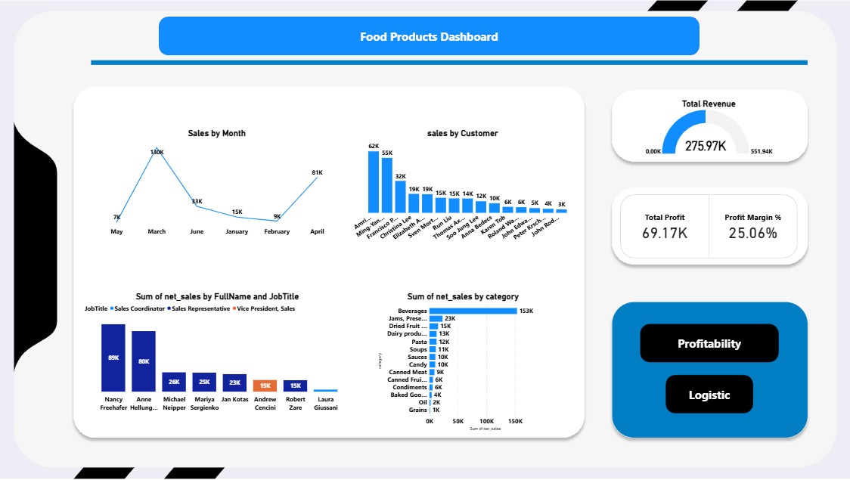

Slide 16
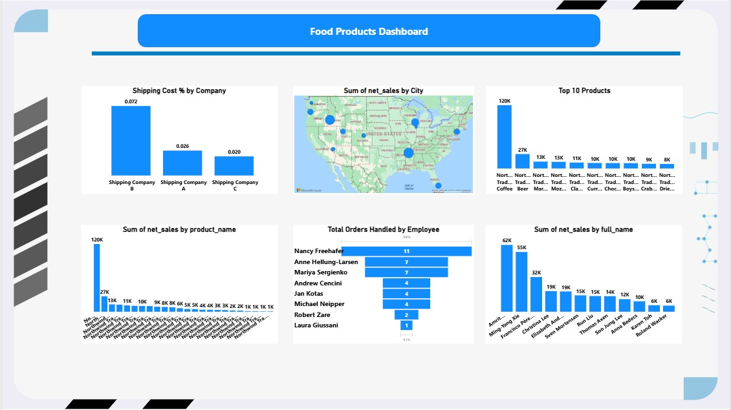

Slide 17
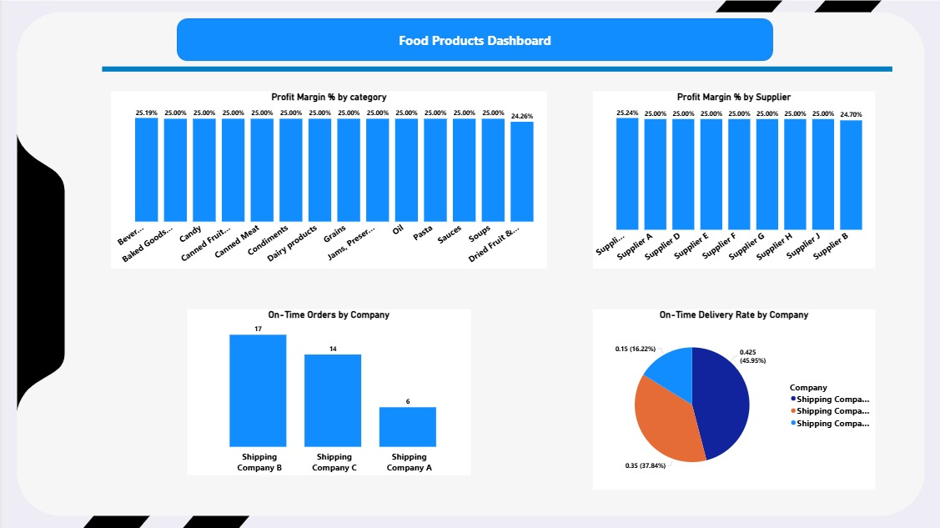

Slide 18


